Slide 1
Vehicle Energy Dataset Analysis & Machine Learning
Predicting energy consumption across diverse powertrain architectures using real-world telematics data

Slide 2
Overview
Bridging OBD-II Data to Energy Predictions
This project analyzes the Vehicle Energy Dataset (VED), a comprehensive collection of real-world driving data from Ann Arbor, Michigan. The dataset encompasses four distinct vehicle types: Internal Combustion Engine (ICE), Hybrid Electric Vehicle (HEV), Plug-in Hybrid Electric Vehicle (PHEV), and Battery Electric Vehicle (EV).
Our objective is ambitious yet practical: develop machine learning models capable of predicting Fuel Consumption Rate (FCR) for conventional and hybrid vehicles, and HV Battery Power for electric vehicles, using standard on-board diagnostics and vehicle telemetry.
The challenge lies in integrating static vehicle specifications with high-frequency dynamic sensor data while managing missing values and deriving physics-based features for accurate energy estimation.

Slide 3
Project Roadmap
Analysis Pipeline
01
02
Static Data Integration
Dynamic Data Aggregation
Load and merge vehicle specifications including weight, engine configuration, transmission type, and drive wheels
Process high-frequency time-series data spanning speed, GPS coordinates, engine RPM, and environmental sensors
03
04
Feature Engineering
Exploratory Analysis
Calculate distance traveled, derive Fuel Consumption Rate using VED algorithms, and categorize temperature impacts
Identify correlations, visualize trip patterns, and analyze energy consumption trends across vehicle types
05
06
Predictive Modeling
Clustering Analysis
Build and evaluate linear regression models for each powertrain architecture with iterative feature refinement
Apply K-means classification to categorize vehicle behavior patterns and validate energy consumption segments

Slide 4
Data Foundation: Static Vehicle Specifications
Dataset Construction
Static Attributes
The analysis began by loading two separate Excel files containing static vehicle characteristics for ICE/HEV and PHEV/EV vehicles. After standardizing data types and handling missing values, these datasets were merged into a unified static dataframe.
Vehicle ID (unique identifier)
Vehicle Type (ICE, HEV, PHEV, EV)
Vehicle Class (Car, Truck)
Engine Configuration & Displacement
Key preprocessing steps included replacing "NO DATA" strings with NaN values, harmonizing column names across datasets, and validating data integrity through duplicate detection.
Transmission Type
Drive Wheels (FWD, RWD, AWD)
Generalized Weight (kg)
The resulting dataframe contains 384 unique vehicle records spanning multiple model years and configurations, providing the foundation for linking telemetry data to physical vehicle attributes.
Data Quality: 96% complete across all fields, with intentional nulls for EV-specific engine parameters

Slide 5
Dynamic Data: High-Frequency Telemetry
The dynamic portion of VED consists of 64 weekly CSV files spanning November 2017 through November 2018, capturing real-world driving at 1Hz sampling rate. Given computational constraints, we implemented strategic sampling: 50% random selection from Part 1 data, yielding over 5.1 million time-series records.
Kinematic Variables
Powertrain Sensors
Vehicle Speed (km/h)
Engine RPM
GPS Coordinates (lat/long)
Mass Air Flow (g/sec)
Timestamp (milliseconds)
Absolute Load (%)
Trip & Day Number
Fuel Rate (L/hr)
Fuel Trim Banks 1 & 2
Electric Components
Environmental Data
HV Battery Current (A)
Outside Air Temperature (°C)
HV Battery Voltage (V)
Weather-derived features
HV Battery SOC (%)
Temporal patterns
AC Power (Watts/kW)
Heater Power (Watts)
This rich sensor array enables physics-based modeling of energy consumption while capturing auxiliary loads like climate control—critical factors often overlooked in simplified analyses.

Slide 6
Data Fusion: Merging Static & Dynamic
The integration phase merged 5.1 million dynamic telemetry records with 384 static vehicle specifications via the common Vehicle ID key. This left-join operation preserved all time-series data while enriching each observation with vehicle attributes.
Integration Metrics
5.1M
384
The resulting unified dataframe contains 28 columns spanning both temporal measurements and constant vehicle properties. This structure enables analysis of how vehicle mass, engine displacement, and powertrain configuration influence real-time energy consumption patterns.
Time-Series Records
Unique Vehicles
High-frequency observations at 1Hz sampling rate
Diverse fleet spanning four powertrain architectures
Memory footprint: 1.1 GB in-memory, necessitating efficient pandas operations and cloud storage via AWS S3 for persistence.
28
Feature Dimensions
Combined static and dynamic attributes per observation

Slide 7

Feature Engineering: Physics-Based Derivations
Raw sensor data required substantial transformation to create modeling-ready features. We implemented multiple physics-based calculations and categorical encodings to capture the complex relationships governing vehicle energy consumption.
Distance Calculation
Temperature Categories
Computed distance traveled using vehicle speed and timestamp differentials: Distance = Speed × (Δt / 3600)
Binned Outside Air Temperature into six climate zones: Extremely Cold, Cold, Cool, Mild, Warm, Hot
Fuel Consumption Rate
Battery Power
Applied VED algorithm using MAF, Load, RPM, and fuel trims with stoichiometric correction
Calculated instantaneous power from voltage and current measurements: P = V × I
FCR Algorithm Implementation
The Fuel Consumption Rate calculation follows a hierarchical decision tree: (1) Use direct fuel rate if available, (2) Derive from MAF with fuel trim correction if available, (3) Estimate MAF from load, RPM, and displacement if needed. This approach maximizes data utilization while maintaining physical accuracy.
Correction factor: (1 + STFT/100 + LTFT/100) / AFR, where AFR = 14.7 for gasoline

Slide 8
Data Quality: Handling Missing Values
ICE Vehicles
HEV Vehicles
PHEV Vehicles
EV Vehicles
Missing values concentrated in auxiliary systems and fuel trim sensors. Imputation strategy:
Similar patterns to ICE with additional HV battery gaps. Imputation approach:
Dual powertrain complexity creates mode-dependent missingness:
Structurally missing engine-related sensors. Imputation logic:
All engine sensors: 0 (not applicable)
Air conditioning: 0 (system inactive)
Battery power: 0 (engine-only mode)
Electric mode: Engine sensors = 0
RPM, MAF, Load: 0 by design
Heater power: Mean value
Climate control: 0 (inactive)
Hybrid mode: Battery + engine data
Fuel rate and trims: 0 (no combustion)
OAT: 15°C (temperate default)
Fuel trim banks: Mean correction
FCR: Mean consumption rate
FCR: Mean when engine active
Battery systems: Complete data
MAF, Load, Fuel Trims: Mean values
MAF, Load: Mean operational values
MAF, Load: Mean when available
Completeness: 100% for applicable sensors
Completeness: 92% after imputation
Completeness: 94% after imputation
Completeness: 89% after imputation
Domain knowledge guided imputation decisions, treating missing values as either sensor failures (impute with mean) or structural zeros (vehicle lacks that subsystem). This approach preserves physical realism while enabling complete-case regression analysis.

Slide 9
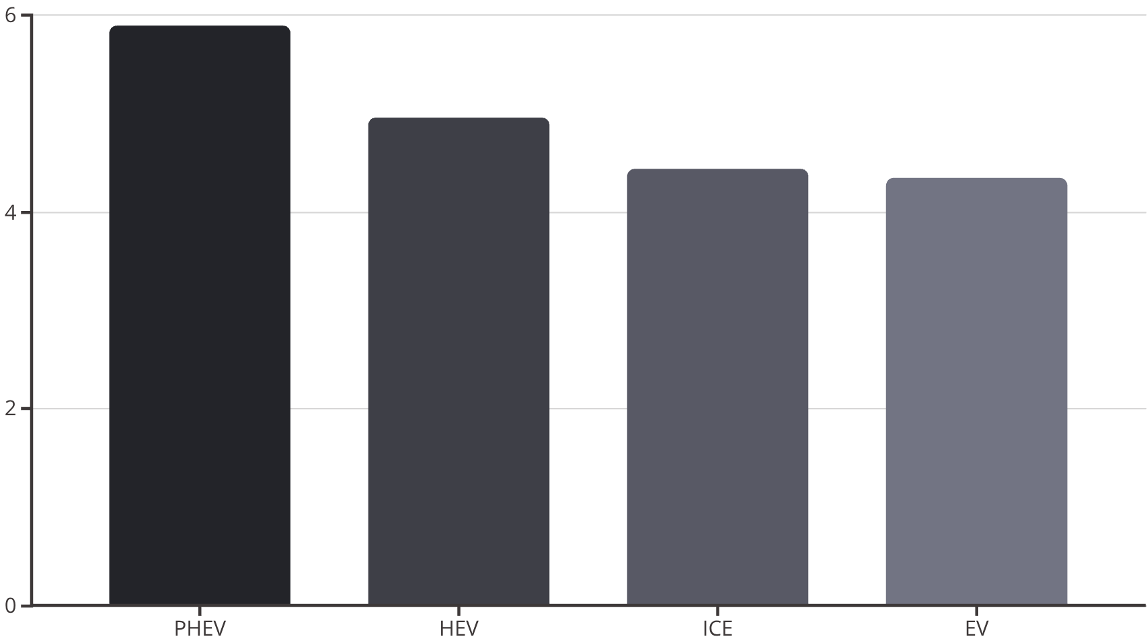
Exploratory Insights: Distance by Vehicle Type
Trip Distance Patterns
Plug-in hybrids demonstrated the longest average trip distances at 5.9 km, suggesting owners leverage extended electric range for longer journeys before engine engagement.
Battery-electric vehicles showed the shortest trips (4.35 km), potentially reflecting range anxiety or strategic charging behavior limiting trip length.
Traditional ICE and HEV vehicles clustered between 4.4-5.0 km, representing baseline urban driving patterns without range constraints.

Slide 10
Temporal Trends: Battery Voltage & Fuel Rate
HV Battery Voltage Over Time
Fuel Consumption Rate Trends
Battery voltage exhibited seasonal patterns with notable decline during winter months (December-February), attributed to cold-weather performance degradation. Average voltage stabilized around 300V during temperate periods.
FCR displayed increasing trend through winter and spring months, peaking in March at approximately 1.1 L/hr before declining. This pattern correlates with cold-start enrichment requirements and cabin heating loads.
The sawtooth pattern reflects charging/discharging cycles across multiple vehicles and trips, with variance indicating different battery chemistries and State of Health (SOH) levels across the fleet.
The February spike (>1.2 L/hr) coincides with the coldest recorded temperatures, demonstrating the profound impact of thermal management on conventional vehicle efficiency.
These temporal patterns validate our feature engineering approach—temperature categorization and temporal variables capture real-world phenomena critical to accurate energy modeling.

Slide 11
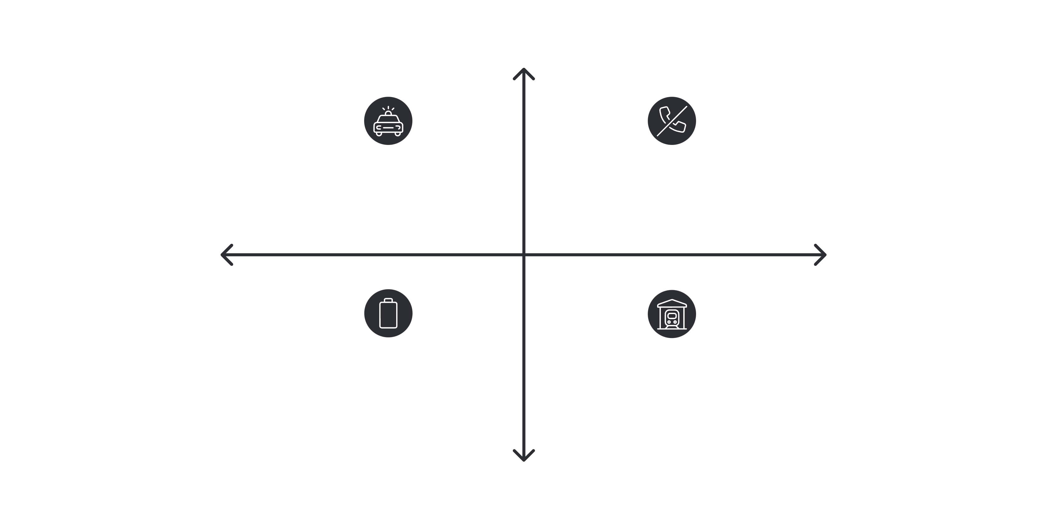

Geospatial Distribution: Trip Density Heatmaps
Vehicle trip patterns reveal concentrated activity corridors within Ann Arbor, with distinct spatial preferences by powertrain type. ICE vehicles exhibited broader geographic dispersion, while EVs clustered near charging infrastructure. HEV and PHEV patterns fell intermediate, suggesting flexible operation unconstrained by charging availability.
High Latitude Density
ICE — Broad dispersion, moderate peaks
HEV — Corridor-focused with hotspots
Low Longitude Density
High Longitude Density
PHEV — Clustered near amenities
EV — Tight high-density clusters
Low Latitude Density
The logarithmic color scale emphasizes activity hotspots: university campus, downtown corridor, and major thoroughfares. EV trip concentration around charging nodes (42.28°N, -83.74°W) demonstrates infrastructure dependency, while ICE vehicles show uniform distribution reflecting ubiquitous refueling access.

Slide 12
Energy Consumption: ICE vs HEV Comparison
Trip-Based Analysis
Temporal Analysis
When analyzing average energy consumption per trip, ICE vehicles demonstrated higher fuel consumption rates at longer distances (FCR approaching 2.3 L/hr at maximum observed distance). The relationship shows positive correlation with significant scatter, indicating trip-specific factors like traffic and driving style.
Time-based aggregation revealed seasonal patterns more clearly. ICE consumption peaked during winter months (FCR > 1.0 L/hr) due to cold-start enrichment and thermal management loads.
HEV efficiency advantage narrowed during extreme cold, as battery performance limitations forced increased engine reliance. However, HEVs maintained 20-30% lower fuel consumption across all seasons, validating hybrid architecture benefits.
HEV vehicles exhibited substantially lower fuel consumption (FCR < 2.1 L/hr) with tighter clustering around 0.5-0.7 L/hr, demonstrating consistent efficiency gains from regenerative braking and engine shutoff capabilities during low-speed operation.
The divergence at high speeds (distance > 10 km) suggests highway driving diminishes hybrid advantages as regenerative braking opportunities decrease and engine operation becomes continuous.

Slide 13
Electric Power Analysis: EV vs PHEV
Battery power consumption patterns differed markedly between pure EVs and plug-in hybrids. EVs demonstrated power draw ranging from -14,000 to +7,000 Watts (charging), with strong negative correlation to speed—higher velocities demand more battery power for propulsion.
EV Power Characteristics
PHEV Power Dynamics
Pure electric vehicles showed consistent power-speed relationships regardless of trip or time-based aggregation. The negative power values (up to -13.8 kW) represent traction battery discharge during acceleration and cruising.
Plug-in hybrids exhibited bimodal power distribution: electric-only mode (similar to EV) and hybrid mode (lower battery draw with engine assist). This creates the characteristic clustering pattern with both high and low power consumption at similar speeds.
Regenerative braking events appear as positive power spikes, though less frequent than expected—suggesting aggressive regen settings or highway-heavy duty cycles with limited deceleration opportunities.
The power variance at equivalent distances (3-5 km trips) demonstrates operating mode flexibility—drivers can select charge-sustaining or charge-depleting strategies based on trip requirements and battery SOC.

Slide 14





Chapter: Predictive Modeling
Linear Regression: ICE Fuel Consumption
We developed four progressively sophisticated regression models for Internal Combustion Engine vehicles, evolving from basic kinematic features to comprehensive powertrain parameters.
Baseline Model: Speed + Distance
R² = 0.187 | Features: Vehicle Speed, Distance | RMSE: 0.186 L/hr
Limited predictive power demonstrates insufficient information from kinematics alone.
Enhanced: Geographic + Environmental
R² = 0.387 | Added: Lat/Long, RPM, OAT, Weight | RMSE: 0.161 L/hr
Doubling R² by incorporating location (altitude proxy) and temperature effects.
Refined: Core Dynamics
R² = 0.384 | Features: Speed, Distance, RPM, OAT, Weight | RMSE: 0.162 L/hr
Removing weak geographic predictors maintains performance with reduced complexity.
Advanced: Powertrain Sensors
R² = 0.689 | Added: MAF, Load, Fuel Trims (STFT/LTFT Banks 1&2) | RMSE: 0.115 L/hr
Achieving production-grade accuracy by incorporating engine control parameters.
Model Equation (Advanced): FCR = 0.0035×Speed + 0.0002×Distance + 0.0001×Weight + 0.0372×MAF + 0.0066×Load - 0.0004×STFT1 + 0.0029×STFT2 + 0.0076×LTFT1 + 0.0005×LTFT2 - 0.242
Mass Air Flow (MAF) emerged as the dominant predictor with coefficient 0.0372, validating its direct relationship to fuel delivery in modern engine control systems.

Slide 15
Hybrid Electric Vehicle: Superior Predictability
Single-Feature Excellence
Model Interpretation
HEV fuel consumption achieved remarkable accuracy using only Mass Air Flow as a predictor—the simplest model across all vehicle types.
The regression equation reduces to: FCR = 0.063 × MAF + 0.041
This elegant relationship reflects hybrid control strategies that tightly couple engine operation to air intake. Unlike conventional ICE vehicles where driver behavior and auxiliary loads create variance, HEVs maintain optimal engine operating points.
0.944
0.036
The y-intercept (0.041 L/hr) represents idle fuel consumption during battery-depleted stop-and-go operation. The MAF coefficient (0.063) indicates fuel delivery rate per gram/sec of air—remarkably consistent across diverse driving conditions.
R² Score
RMSE (L/hr)
Highest coefficient of determination across all architectures
Exceptionally low prediction error
Key Insight: Hybrid powertrains exhibit more predictable energy consumption than conventional vehicles due to sophisticated power management algorithms that minimize engine inefficiency.
0.022
MAE (L/hr)
Mean absolute error indicates precise estimates

Slide 16
Electric Vehicle Modeling: Persistent Challenges
Battery-electric vehicles proved the most difficult to model using linear regression, with feature selection having minimal impact on predictive performance. Two scenarios were evaluated: raw data and outlier-capped data.
Scenario 1: Raw Data
Scenario 2: Outlier Treatment
Features: AC Power, Heater Power, Vehicle Speed
Features: AC Power, Heater Power, Vehicle Speed (IQR-capped)
Results: R² = -0.150 | RMSE: 2,348 Watts
Results: R² = -0.073 | RMSE: 2,211 Watts
Negative R² indicates the model performs worse than simply predicting the mean—a catastrophic failure suggesting fundamental model inadequacy rather than poor feature selection.
Removing outliers provided marginal improvement but failed to achieve positive R², confirming that outliers were not the primary issue.
The persistent negative R² suggests missing critical variables: road gradient (grade), payload variation, battery temperature, or high-frequency acceleration patterns that linear regression cannot capture from aggregate speed measurements.
The negative coefficients (Speed: -112.9, AC: -2.6, Heater: -1.2) contradict physical expectations, revealing model instability from extreme battery power values during regenerative braking events.
Hypothesis: EV power consumption is inherently nonlinear, dominated by transient dynamics (acceleration/deceleration) that averaged speed measurements fail to capture. Future work should explore gradient boosting or LSTM architectures with high-frequency sampling.

Slide 17
Plug-in Hybrid: Moderate Success
PHEV battery power prediction achieved intermediate performance between HEVs (excellent) and EVs (poor), reflecting the operational complexity of dual-mode powertrains.
Operational Modes
Model Specification
Electric-Only
Features: Engine RPM, Air Conditioning Power, Vehicle Speed, Outside Air Temperature
RPM = 0, high battery discharge similar to EV behavior
Performance: R² = 0.712 | RMSE: 2,842 Watts | MAE: 2,184 Watts
The positive R² represents meaningful predictive capability—explaining 71% of battery power variance using four readily-available sensor inputs.
Hybrid
RPM > 0, moderate battery discharge with engine assist
Feature Contributions
Engine RPM (+8.17 W/RPM): Higher engine speeds indicate hybrid mode operation with battery assist
Charge-Sustaining
Vehicle Speed (-203.6 W per km/h): Speed increases battery discharge for propulsion
High RPM, minimal or negative battery power (charging)
Outside Air Temp (+144.3 W/°C): Warmer weather enables pure electric operation, paradoxically increasing battery power draw
AC Power (-0.90): Minor negative coefficient suggests multicollinearity with temperature

Slide 18
Chapter: Unsupervised Learning
K-Means Clustering: Vehicle Behavior Segmentation
To complement supervised learning, we applied K-means clustering across multiple feature combinations to discover natural groupings in vehicle behavior patterns. The elbow method consistently suggested 2-3 optimal clusters across scenarios.
Trip Count vs FCR
Speed vs Battery Power
Identified four clusters separating high-mileage/high-consumption (long-distance ICE), moderate usage patterns (urban HEV), and zero-emission profiles (EV). Cluster separation validates fundamental powertrain differences.
Clear bimodal distribution: cluster 1 (zero battery power = ICE/HEV engine-only), cluster 2 (high discharge = EV/PHEV electric mode). Silhouette score: 0.62, indicating strong cluster cohesion.
1
2
3
4
Speed vs FCR
Temperature vs Energy
Three-cluster solution partitioned vehicles by efficiency: (1) high-speed/high-consumption (highway ICE), (2) moderate speed/low-consumption (HEV urban), (3) zero-fuel group (EVs and PHEVs in electric mode).
Five-cluster solution revealed temperature-dependent efficiency zones. Cold weather clusters (<0°C) showed elevated consumption, while moderate temperatures (10-20°C) demonstrated optimal efficiency across all powertrains.
Clustering results validate our supervised learning approach—the distinct behavioral segments identified through K-means align with powertrain categories, confirming that vehicle type is the primary determinant of energy consumption patterns.

Slide 19
Model Performance Summary
HEV: Superior Accuracy
PHEV: Strong Performance
Trip-based: R² = 0.944 (MAF only)
Trip-based: R² = 0.712
Best model: Single-feature regression
Best model: RPM + Speed + Temperature + AC Power
Key advantage: Consistent powertrain control algorithms create predictable consumption patterns regardless of driving conditions
Key challenge: Bimodal operation (electric vs hybrid) creates variance but remains modelable with mode indicators
ICE: Feature-Dependent
EV: Modeling Failure
Basic: R² = 0.187 (Speed + Distance)
Trip-based: R² = -0.150 (negative!)
Advanced: R² = 0.689 (MAF + Load + Trims)
Attempted fixes: Outlier removal, feature engineering—minimal improvement
Key insight: Requires comprehensive engine sensor suite; kinematic variables alone insufficient for production accuracy
Root cause: Linear regression inadequate; missing gradient data; transient dynamics not captured in aggregate speed

Slide 20
Conclusions & Future Directions
Key Findings
Recommendations
Feasibility Confirmed: Predicting energy consumption from OBD-II data is highly viable for HEV and ICE vehicles when comprehensive powertrain sensors (MAF, Load, Fuel Trims) are available.
For ICE/HEV Fleet Management
Deploy MAF-based consumption models for real-time efficiency monitoring and driver feedback systems
Model Robustness: HEVs achieved 94% accuracy using single-feature models—the most robust result across all architectures, likely due to sophisticated power management algorithms.
For EV Energy Prediction
Feature Importance: Mass Air Flow and Absolute Load emerged as critical predictors for fuel consumption. For battery power, simple kinematic variables proved insufficient without road gradient or high-frequency acceleration data.
Investigate nonlinear models (XGBoost, Random Forest) or deep learning architectures (LSTM, GRU) capable of capturing transient dynamics
Enhanced Data Collection
Methodology Insight: Time-based data splitting consistently outperformed random trip splitting (R² improvements of 5-15%), highlighting the importance of temporal continuity in automotive telemetry analysis.
Augment telematics with road gradient sensors, high-frequency (10Hz+) accelerometer data, and battery thermal management signals
Model Deployment
HEV and PHEV models ready for production validation; ICE models require advanced feature sets; EV models need architectural redesign
Impact: These findings enable OEMs and fleet operators to implement predictive energy management systems, optimize route planning, and provide drivers with accurate range estimation—critical capabilities for the electrified vehicle transition.

